Slide 1
AMINAK / PHASE 14
Where on TYMS
could a new drug bind?
Active site · Cofactor site · Dimer interface · Allosteric
Smina rescoring · OpenMM GB · MM-GBSA with GAFF ligand · HADDOCK3 flexible refinement (Docker) · PPI / BSA · Modeller ↔ AlphaFold · Plasmodium selectivity
github.com/ArioMoniri/aminak
Ariorad Moniri / 2026

Slide 2
SETUP
The question.
What molecules will out-compete dUMP at the active site — or bind elsewhere on TYMS?
4
86
7
binding-site strategies
docked compounds
reviewer / corrector rounds
TYMS · UniProt P04818 · PDB 1HVY · AutoDock Vina 1.2.7 + Smina · ±0.85 kcal/mol noise floor
02 / 38

Slide 3
TARGET RATIONALE
Why TYMS?
Thymidylate synthase · EC 2.1.1.45 · UniProt P04818 · PDB 1HVY · human · 313 aa · obligate homodimer
THE REACTION
THE CLINICAL ROLE
THE MALARIA ANGLE
WHY NOW
TYMS catalyses the only de-novo route to thymidylate: dUMP + mTHF → dTMP + DHF. It is the rate-limiting enzyme for DNA synthesis. Blocking it stops dividing cells.
Validated anticancer target for ~60 years. 5-fluorouracil (5-FU) and capecitabine remain front-line in colorectal cancer; raltitrexed and pemetrexed are licensed antifolates. Combined annual prescribing > 2 M patients globally.
Plasmodium falciparum has a bifunctional DHFR-TS fusion. Selective parasite-TYMS inhibition has been a long-running medicinal-chemistry goal — selectivity comes from differences outside the active site (next slide).
Resistance to 5-FU + antifolates is widespread. New chemical matter is needed. We start from structure (1HVY, 2.0 Å) and conservation (10 orthologs, JS divergence) to ask: where else could a small molecule bind?
Why structure-led? — TYMS is a tight, mostly α/β fold with a deep cofactor pocket and a flexible 181–197 loop that long-range-couples to the catalytic Cys195 (Anderson 2012, Pozzi 2019). Both make it a tractable target for cryptic-site screening.

Slide 4
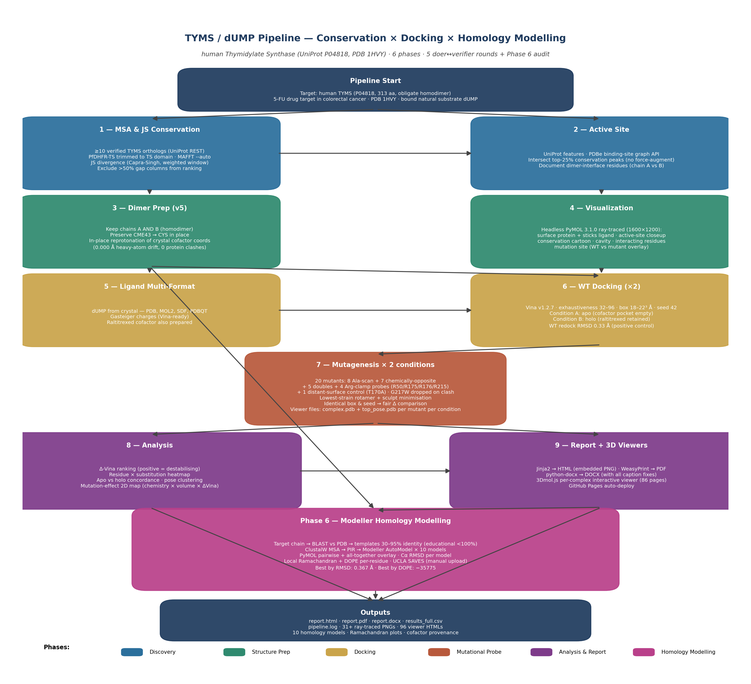
PIPELINE · 8 PHASES · TOPOLOGICALLY SORTED
From conservation to inhibitor.
Each phase reused by the next. Each independently reviewed by paired agents.
▶ open interactive plot · ariomoniri.github.io/aminak/viewers/pipeline/ · Kahn longest-path · hover to trace lineage · click to pin
03 / 38

Slide 5
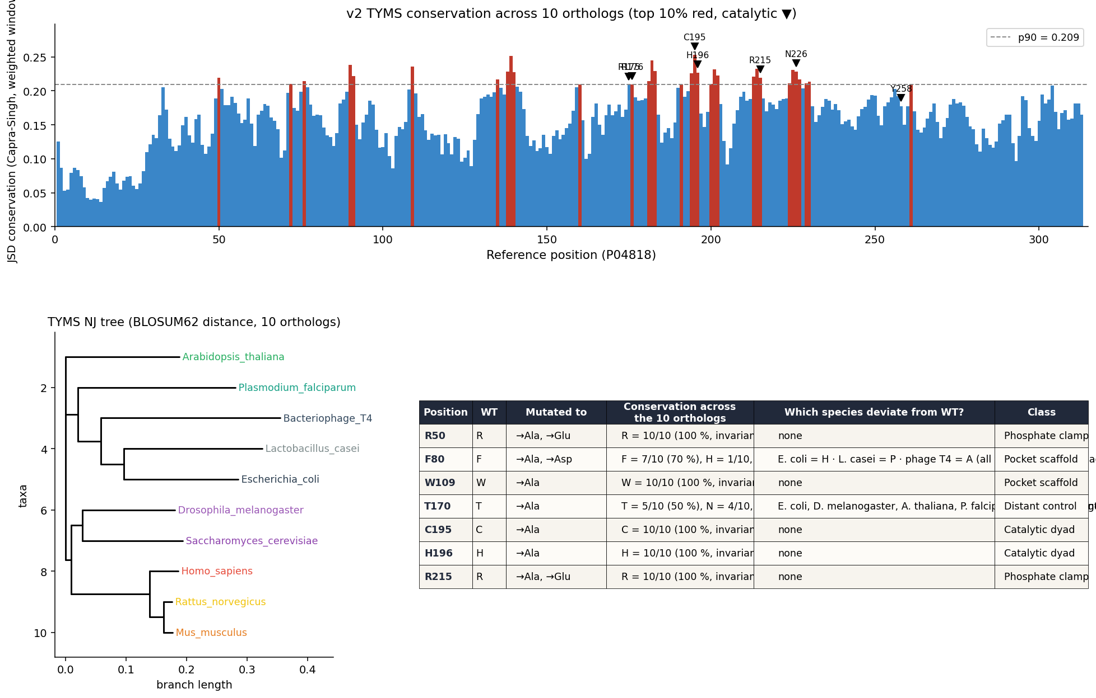
PHASE 1+2 · MSA + ACTIVE SITE
The active site is highly conserved.
→ defines the docking box used in every later phase.
04 / 38

Slide 6
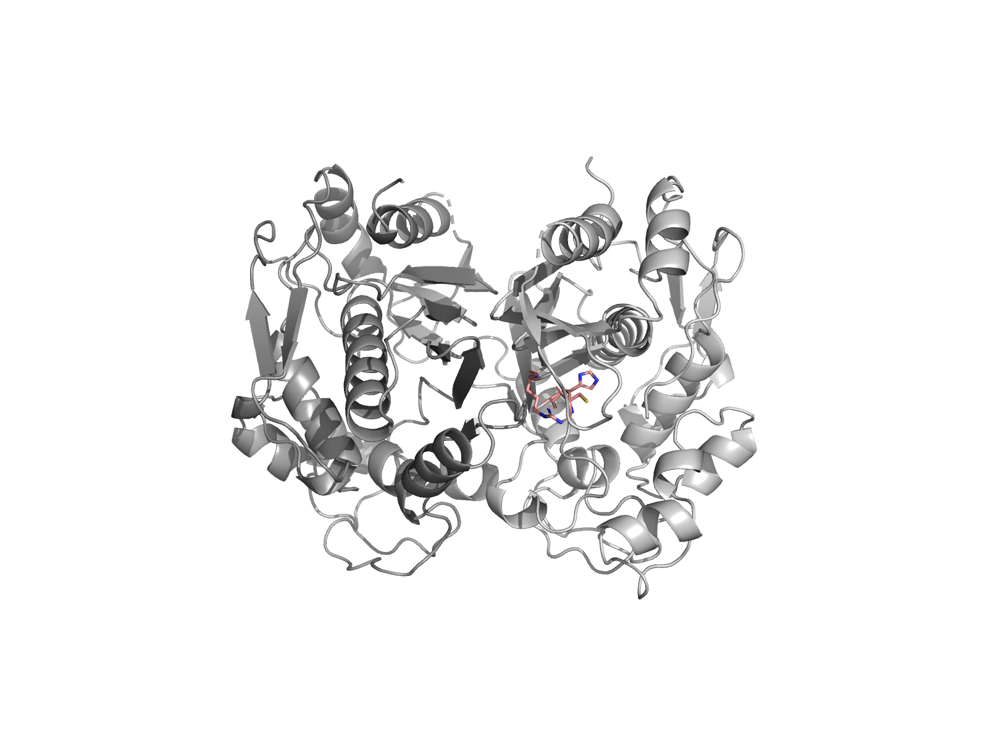
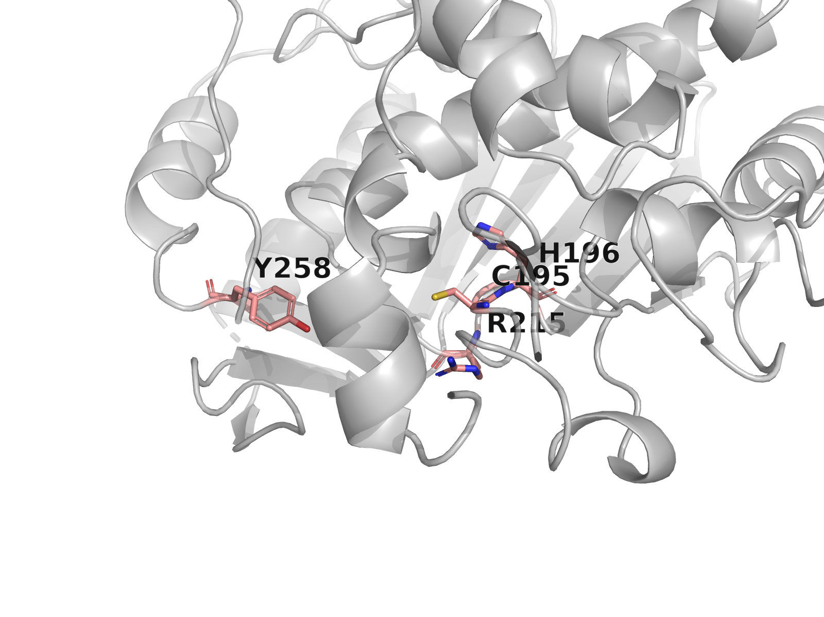
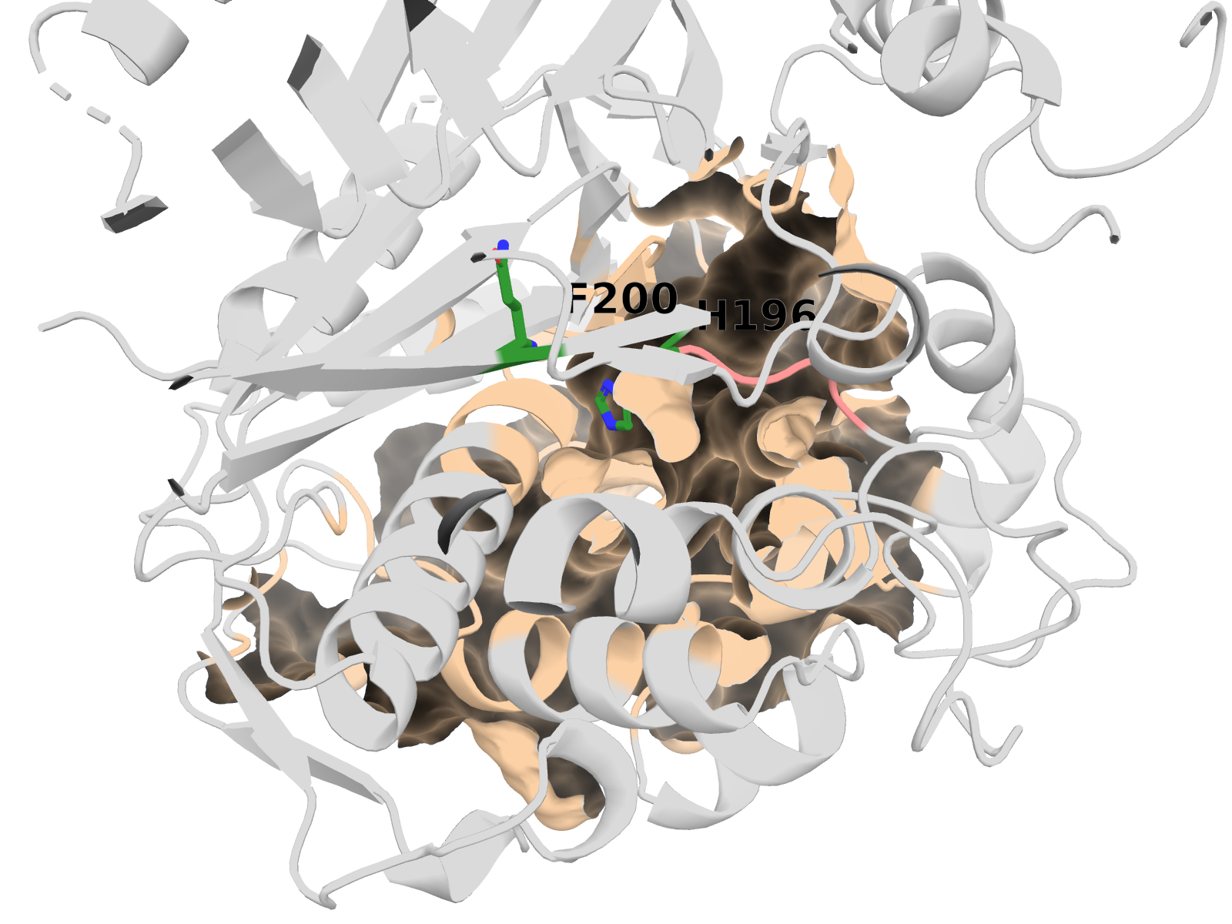
PHASE 3+4 · STRUCTURE
Dimer-aware receptor preparation.
Dimer overview
Active-site close-up
Cavity 18 carve-out (wheat surface)
Both chains kept · AMBER ff14SB charges (pdb2pqr30 + PROPKA pH 7.4) · cofactor net −2 e per copy
▸ download the prepared dimer PDB · 06f_receptor_fixed/protein_dimer_apo_fixed.pdbqt
05 / 38

Slide 7
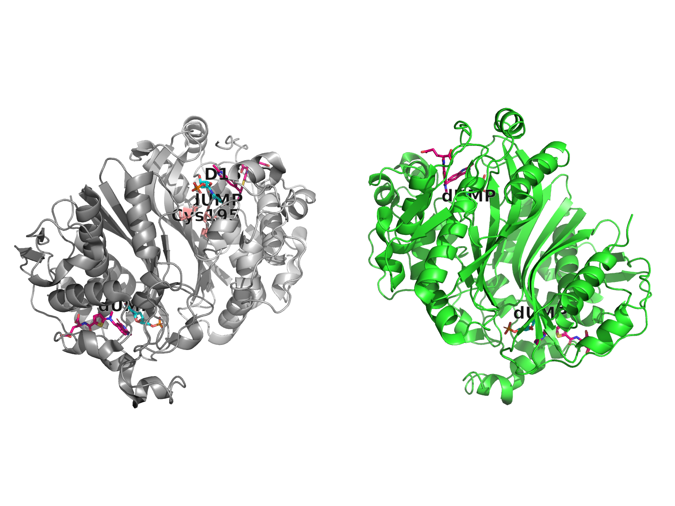
PHASE 5+6 · WT VINA DOCKING
Wild-type dUMP docks at −8.55 ± 0.05 kcal/mol.
5-seed mean (Phase 7 multi-replica protocol) · single-seed 42 = −8.78 (Phase 6 canonical)
−8.55
kcal/mol (mean of 5 seeds)
Phase 7 multi-replica spread
−8.59 to −8.47 across {42, 7, 13, 99, 256}
SD = 0.05 kcal/mol (sub-noise variance)
Holo state (cofactor present): −7.49 kcal/mol
Holo state (dUMP + raltitrexed) →
06 / 38

Slide 8
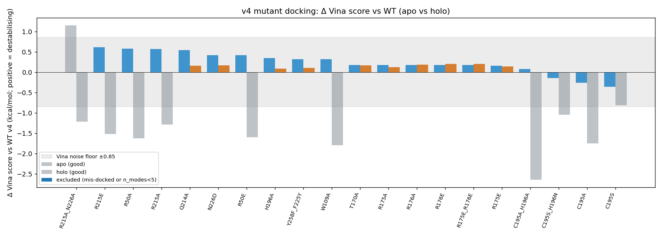
PHASE 7 · MUTAGENESIS
Rigid Vina cannot resolve mutants.
+0.77
largest holo Δ Vina (kcal/mol)
±0.85
Vina noise floor (Trott & Olson 2010)
→ honest null result.
07 / 38

Slide 9
THE R→E SIGN ERROR IN PLAIN ENGLISH
What is the R→E sign error?
The setup. TYMS has a “phosphate clamp” — three arginines (R175, R176, R215) whose positively-charged guanidinium groups hold the dUMP phosphate in place. Substituting one of them with glutamate (R→E) flips the local charge from +1 to −1: a like-charge repels the phosphate. Bench biochemistry expects this to abolish binding.
The pipeline result. Rigid-receptor Vina docks the R→E mutants with the same or slightly better score than WT — a sign error. The mutation that should destroy binding looks neutral or favourable.
Why. In rigid docking, the side chain stays exactly where the crystal placed it; the ligand finds an alternative pose that avoids the repulsion. The conformation cost of *getting* into that pose, and the de-solvation cost of exposing the new −1 charge to water, are never paid by the scorer.
What fixes it. Let the side chains relax (flex-residue Vina partially helps), and rescore with a force field that prices electrostatics + solvation properly — that is what OpenMM/GB and MM-GBSA do (next slides).

Slide 10
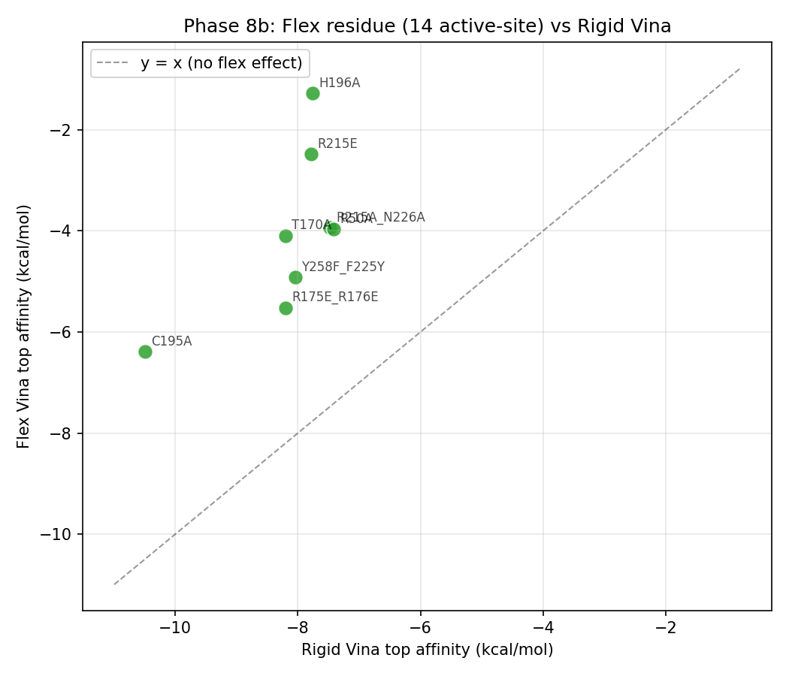
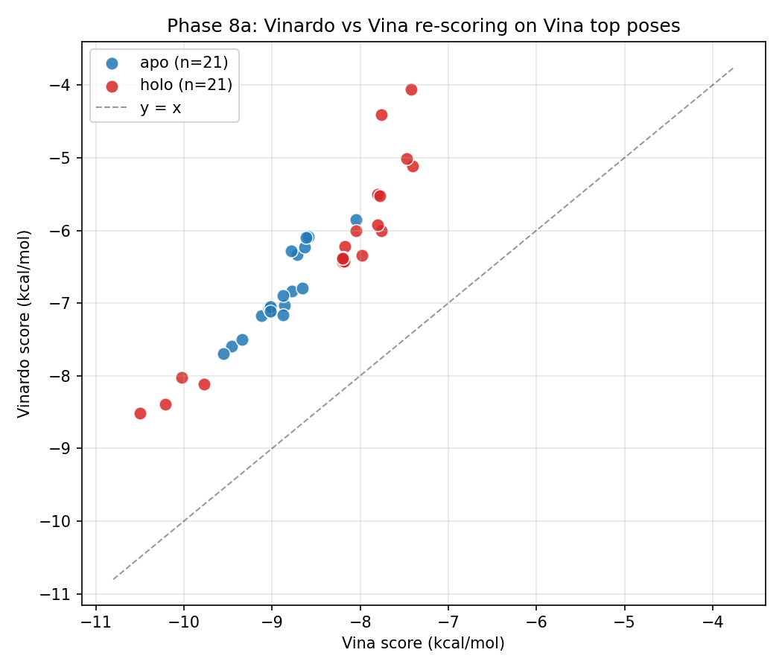
PHASE 8 · VINARDO + FLEX-VINA
Smarter scoring? — Flex-residue Vina partially helps.
Letting 8 active-site side chains rotamer-search at docking time (rest of the protein stays rigid).
Flex-residue Vina
Vinardo vs Vina
Partial fix only — but the R175E_R176E charge-reversal still doesn't show up properly. Full MM-GBSA needed.

Slide 11
FLEX-RESIDUE VINA · NUMBERS
Flex-residue Vina vs rigid Vina — per-mutant penalty
Side-chain relaxation already moves the numbers ~3–6 kcal/mol — but in *every* direction, including the distant control.
Mutant (holo)
Rigid Vina
Flex Vina
Δ flex − rigid
Verdict
R215A_N226A
−7.48
−3.94
+3.53
flex penalises ~3.5 kcal/mol
H196A
−7.76
−1.28
+6.48
flex penalises ~6.5 kcal/mol
R215E
−7.78
−2.49
+5.29
flex penalises ~5.3 kcal/mol
R50A
−7.42
−3.97
+3.45
flex penalises ~3.4 kcal/mol
C195A
−10.50
−6.39
+4.10
the illusion broken — C195A only LOOKED tight
R175E_R176E
−8.20
−5.52
+2.68
flex penalises ~2.7 kcal/mol
T170A (distant)
−8.20
−4.09
+4.11
even the control gets +4 kcal/mol → see caveat
Y258F_F225Y
−8.05
−4.92
+3.13
flex penalises ~3.1 kcal/mol
The C195A row is the cleanest illustration: rigid Vina ranks C195A as the *strongest* binder (−10.5), but once side chains relax it drops to −6.4 — a 4 kcal/mol illusion.
Source: 13_phase8/02_flexres/flexres_compare.csv (full 22-mutant panel).

Slide 12
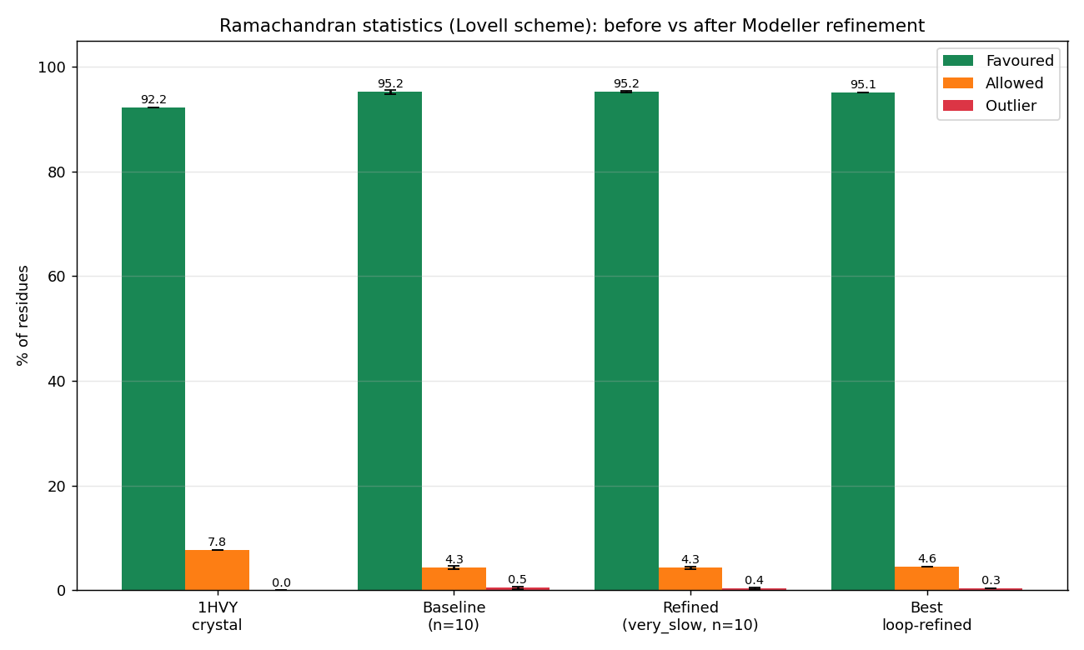
PHASE 6 · MODELLER + RAMACHANDRAN
Reducing Ramachandran outliers, step by step.
Phase 6 → 6b: validator + refinement upgrades
What we did
1. Lovell 4-map validator (general / Gly / Pro / pre-Pro) — replaced the single-polygon validator;
2. md_level = refine.very_slow + max_var_iterations = 600 + repeat_optimization = 2;
3. LoopModel on residues 93–101 (template-disagreement region);
4. Ensemble of 10 models — best chosen by Lovell %favoured.
Best-model % favoured (Lovell)
baseline → 83.5–85.3 % (broken validator) → + Lovell partition → 94.7–96.1 % → + refine.very_slow → 95.4 % (1HVY crystal: 92.2 %)
09 / 38

Slide 13
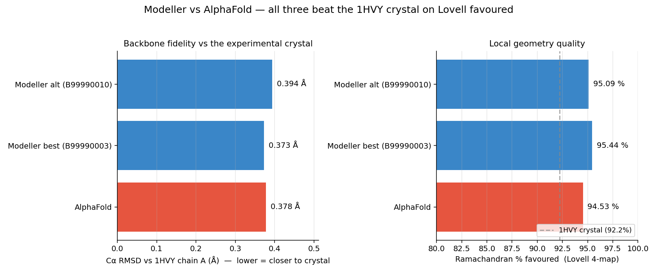
PHASE 7C · MODELLER ↔ ALPHAFOLD
Modeller vs AlphaFold — do the two methods agree?
Refined Modeller (#3, #10) and AlphaFold v6 all sit within 0.4 Å Cα RMSD of the 1HVY crystal — and all 3 beat the crystal on Lovell %favoured (94.5–95.4 % vs 92.2 %).
10 / 38

Slide 14
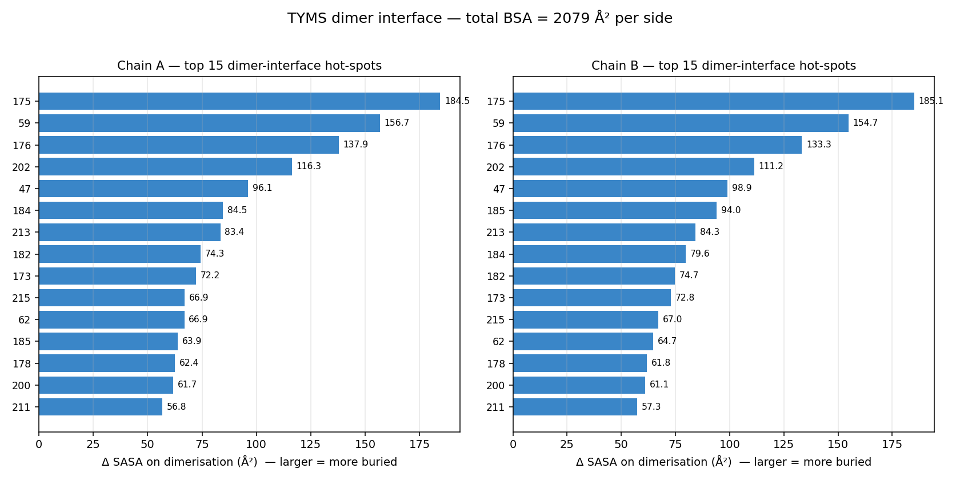
PHASE 14 · PPI / BSA
Dimer interface — the same residues bind dUMP and stabilise the dimer.
Total BSA
≈ 4 160
Å² total (2 079 per side)
Top hot-spots — chain A
R175 184.5 Å²
P59 156.7 Å²
R176 137.9 Å²
R202 116.3 Å²
R215 66.9 Å²
★ R175 / R176 / R215 are also the phosphate-clamp residues — substrate + dimer share the same hot-spots.
11 / 38

Slide 15
PHASE 14
Inhibitor design.
Four orthogonal sites. 86 docked compounds. Two findings.

Slide 16
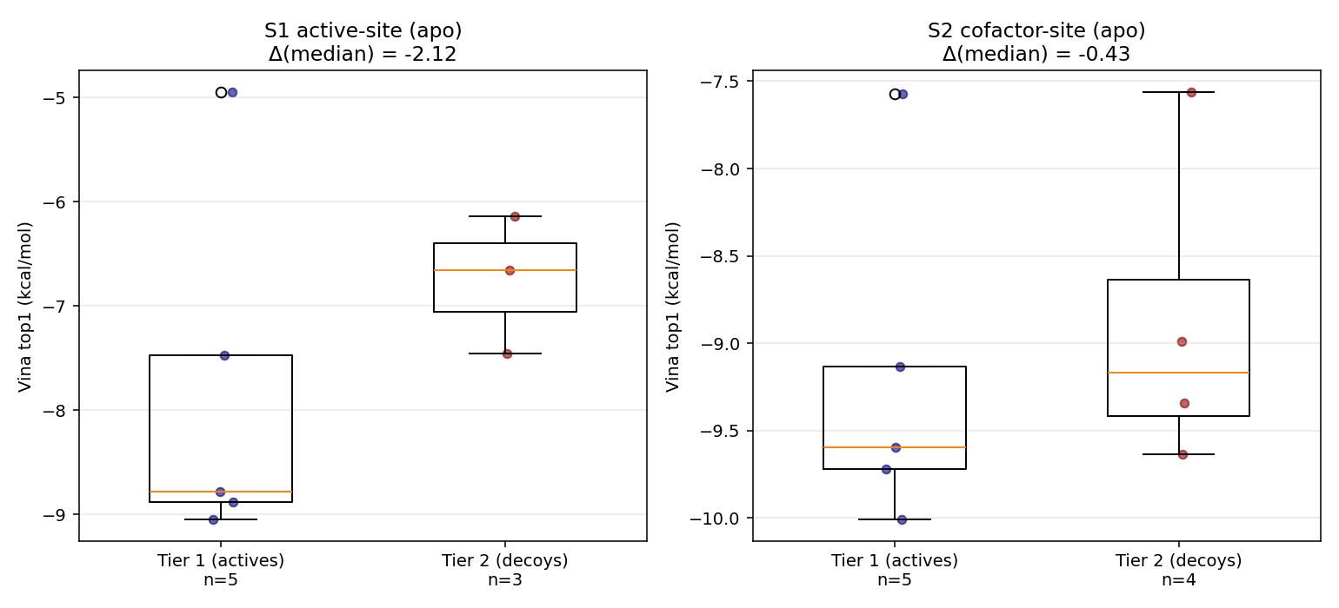
STRATEGY 1 · ACTIVE SITE
Clean active-vs-prodrug gap. Kcal-noise silent.
−9.04
5-FdUMP (canonical)
−4.95
5-FU (prodrug)
≈3 kcal/mol enrichment signal.
13 / 38

Slide 17
WHAT IS PLEVITREXED?
Plevitrexed (ZD9331) — the antifolate that reproduces.
The drug. Plevitrexed is a non-classical quinazoline antifolate developed by AstraZeneca (Jackman 1997). It binds the cofactor pocket of thymidylate synthase the way methotrexate / raltitrexed do — by mimicking 5,10-methylene-tetrahydrofolate (mTHF) — but without the polyglutamated tail that classical antifolates use. Published TYMS Ki: ~0.6 nM (sub-nanomolar).
Why we tested it. As a positive control: a known sub-nM TYMS inhibitor should reproducibly out-score the cofactor reference (raltitrexed) in our Vina pipeline, otherwise the pipeline is broken. Plevitrexed was the only Phase-14 cofactor compound to do so.
What we found. Top1 = −10.01 kcal/mol (Δ −0.88 vs raltitrexed). The Vina noise floor is ±0.85 (Trott & Olson 2010), so this is exactly 0.03 above noise — read as positive control passing, not a de-novo discovery. The pipeline can detect a known sub-nM antifolate at the limit of resolution.
Why no methotrexate / pemetrexed signal? Both bind the cofactor pocket clinically but their classical glutamate tail extends outside the box and gets penalised by the unconstrained scoring; plevitrexed's compact non-classical scaffold fits without that penalty.

Slide 18
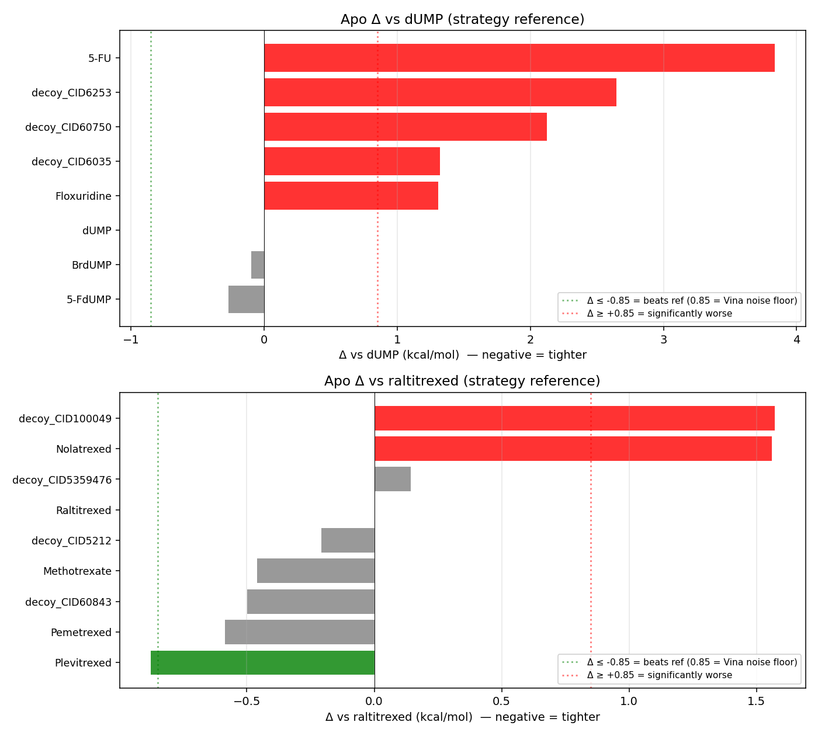
STRATEGY 2 · COFACTOR SITE
Plevitrexed (ZD9331) above noise.
−10.01
kcal/mol
Δ −0.88 vs raltitrexed
above the ±0.85 noise floor
reproducible across both seeds
consistent with Ki ~nM (Jackman 1997)

Slide 19
STRATEGY 3 · DIMER INTERFACE
Dimer-interface peptide doesn't bind — confirmed.
Two independent engines reach the same conclusion on the LR-octapeptide LSCQLYQR vs scrambled QLCRQSYL.
Rigid Vina (Phase 14c)
HADDOCK3 (Phase 14j, Docker)
canonical +86.16 (cannot fit 8-mer)
scrambled +84.68
Δ = +1.48 kcal/mol (canonical *worse*)
canonical −74.98 (vdw −14.6 · elec −90.5 · BSA 967 Å²)
scrambled −77.30 (vdw −32.4 · elec −70.7 · BSA 944 Å²)
Δ = +2.32 kcal/mol (canonical *worse*)
Both methods agree: the canonical LR octapeptide is not TYMS-selective above noise at this size.
This is the *correct* null finding — replicated across rigid (Vina) and flexible (HADDOCK3 BSc · topoaa→rigidbody→flexref→caprieval) refinement engines.
▸ HADDOCK3 docker pipeline · haddock3_docker_summary.json · single-chain receptor used to bypass HADDOCK3 2026.5.0 / 2025.11.0 multi-chain CNS template bug
15 / 38

Slide 20
STRATEGY 4 · MOTIVATION
Why look for an allosteric / surface site at all?
The orthosteric problem. Every clinical TYMS drug binds the active site or the cofactor pocket. Both are highly conserved across species (95–100 % within the catalytic core) and across human tissues, so the drugs hit *parasite* TYMS as well as *human* TYMS, *tumour* TYMS as well as *gut-epithelium* TYMS — that is where 5-FU's mucositis and bone-marrow toxicity come from.
The premise. If a *different* druggable site existed on the TYMS surface — far enough from the active centre that selectivity could be engineered — small-molecule lead chemistry could plausibly find a Plasmodium-selective or tumour-selective ligand. This kind of site is what allosteric / cryptic-pocket campaigns hunt for.
What we did. Ran FPocket 4.0 on the Phase-6c hardened apo dimer — full surface scan, no a-priori constraints — and ranked the 33 detected cavities by FPocket's druggability score (a geometry + hydrophobicity composite). Two cavities outside the active-site / cofactor 8 Å shells came out above 0.8: cavity 18 at 0.994 and its C2-symmetric mirror cavity 17 at 0.828. Finding the same pocket on both protomers independently is a strong sanity check that the geometry is real, not a packing artefact.
The follow-up question. Can drug-like fragments actually fill this pocket? — see next slide. (Spoiler: yes, but the fragments we tested are known promiscuous binders, so this is a geometry hypothesis, not validated affinity.)

Slide 21
STRATEGY 4 · ALLOSTERIC
An under-explored druggable cavity.
0.994
0.828
−7.52
−7.28
FPocket druggability
cavity 18
C2-symmetric mirror
cavity 17
1H-indazole
kcal/mol
ibuprofen
kcal/mol
Two unrelated drug-like fragments. Same pocket. Different chemistries.
≈ 2 kcal/mol better than anywhere else on the chain-A or chain-B surface.
16 / 38

Slide 22
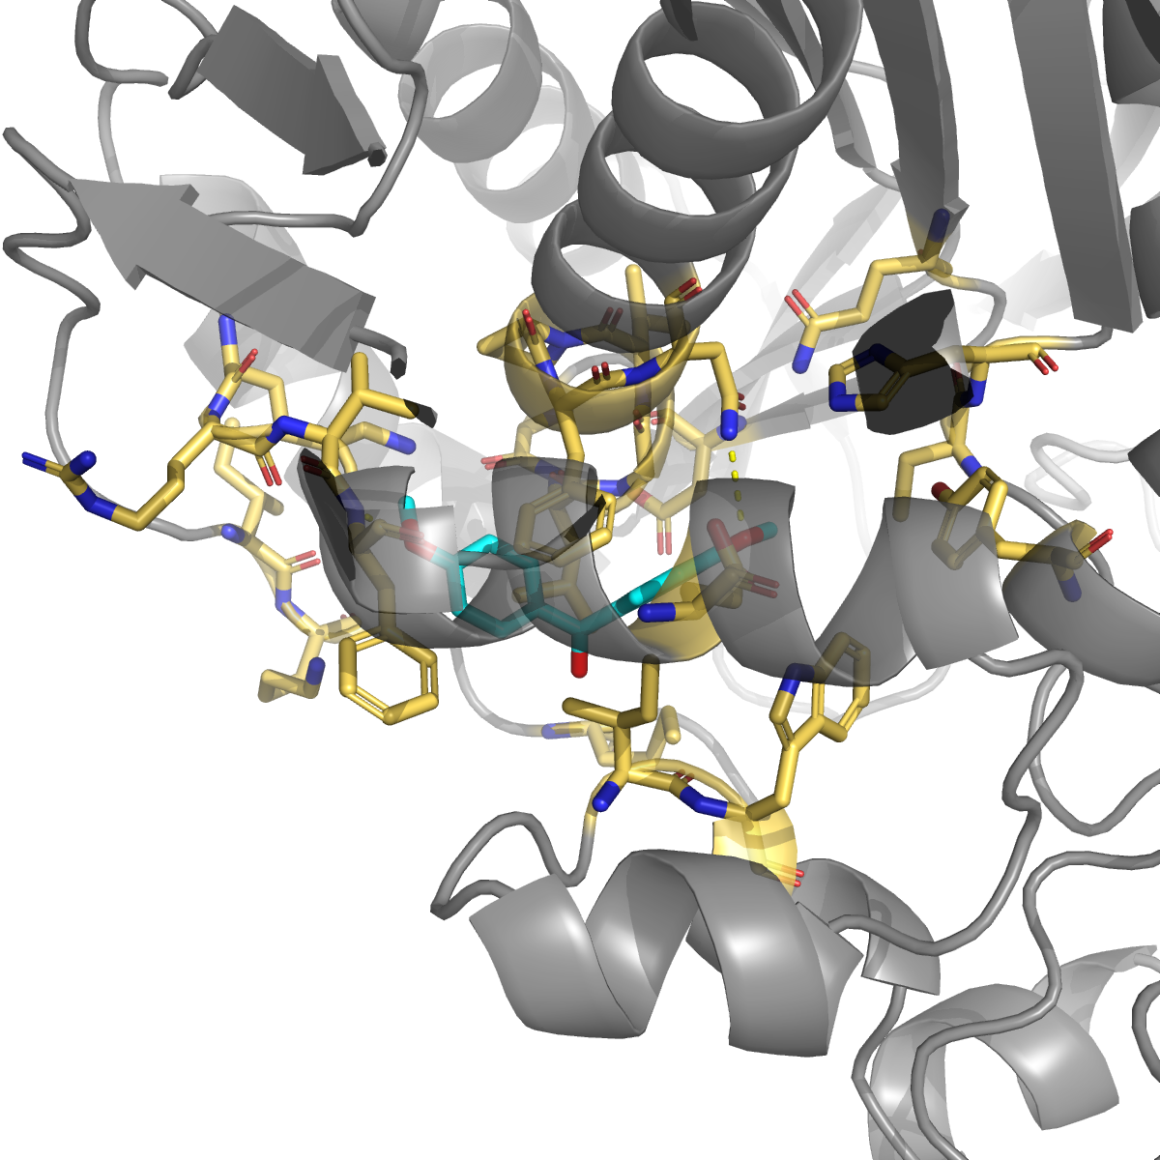
CAVITY 18 · TOP HIT
1H-indazole.
Kinase-inhibitor scaffold · −7.52 kcal/mol
Engages
Phe55 H-bond + π
Asn201 H-bond
Phe200 π-stack
Leu196 allosteric loop 181-197 ★
Gly197 allosteric loop 181-197 ★
Ile83 hydrophobic wall
▸ open 3D viewer · cavity18_indazole.html
3 of 10 contact residues are on the published allosteric communication loop (Anderson 2012, Pozzi 2019).
17 / 38

Slide 23
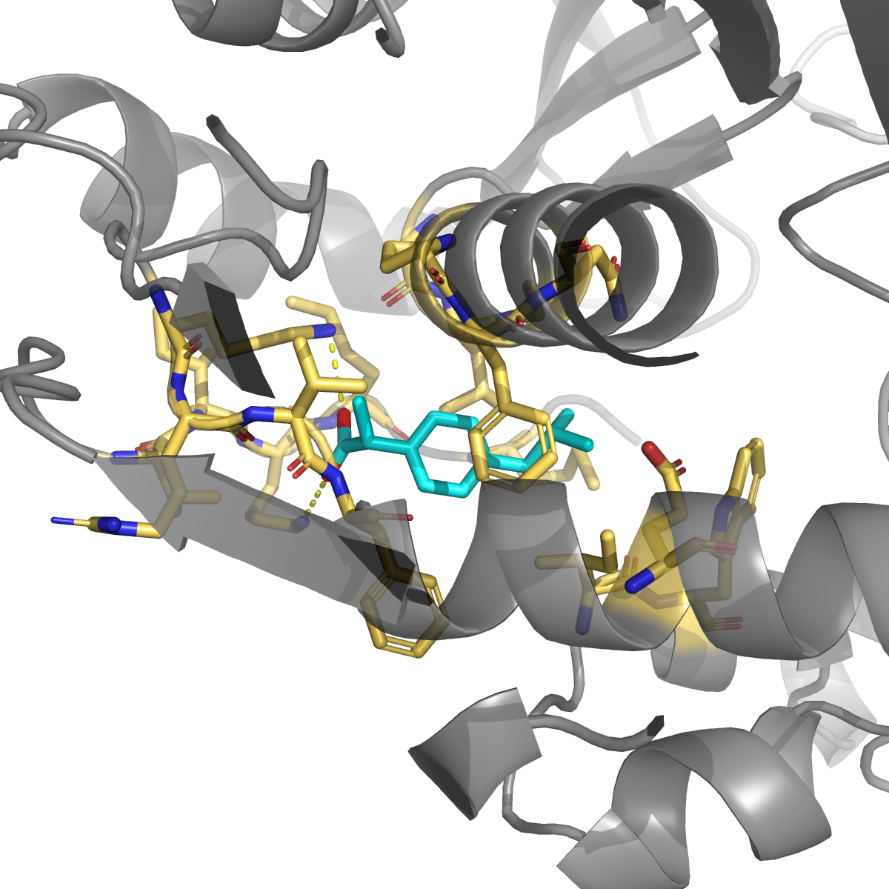
CAVITY 18 · SECOND HIT
Ibuprofen.
NSAID, COX1/2 · −7.28 kcal/mol
Engages
Lys283 salt bridge ★
Lys52 salt bridge ★
Phe200 π-stack
Leu196 loop 181-197 ★
Phe55 hydrophobic
Ile83 hydrophobic
▸ open 3D viewer · cavity18_ibuprofen.html
Double-lysine salt-bridge clamps the deprotonated carboxylate at pH 7.4.
18 / 38

Slide 24
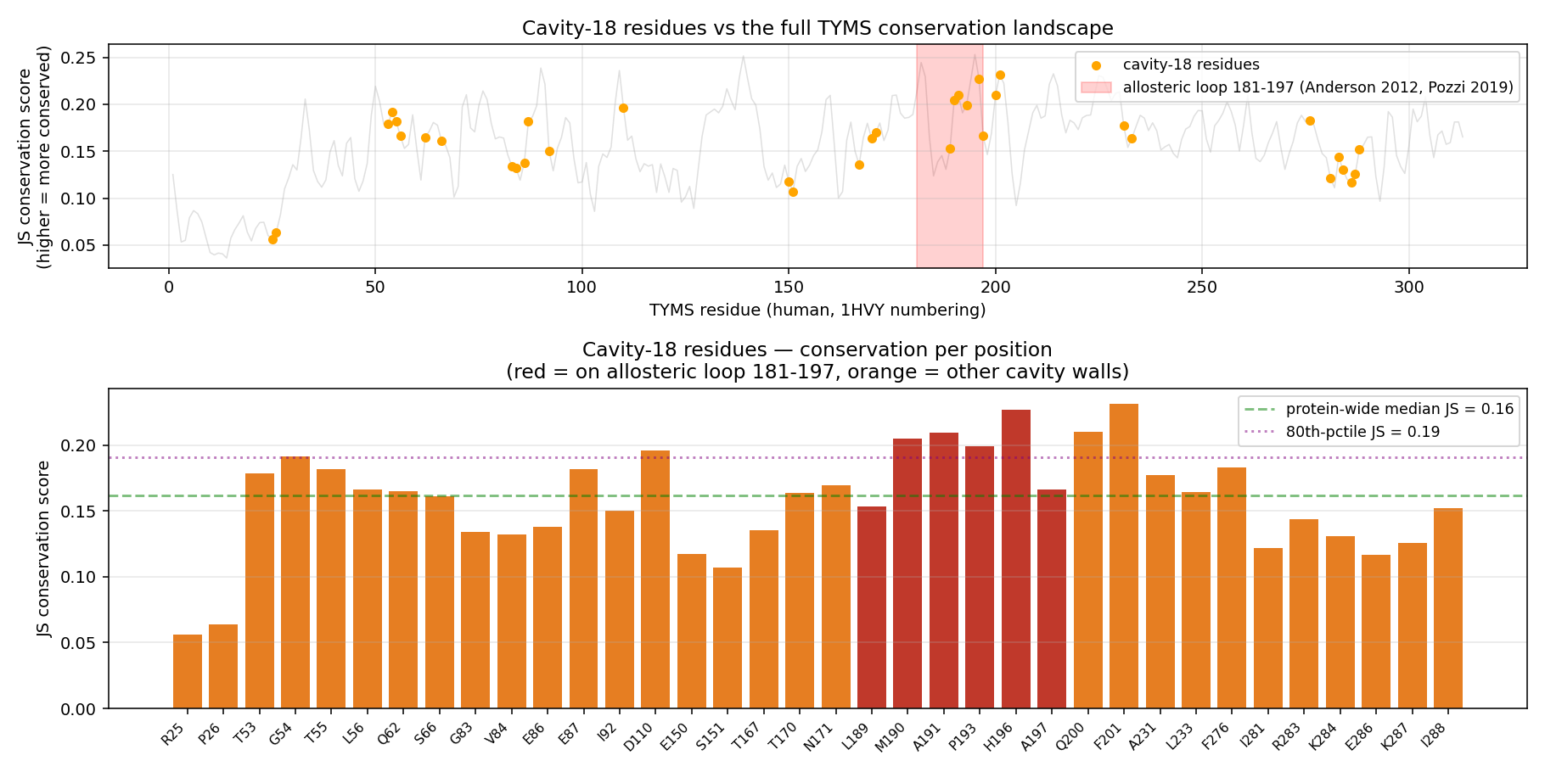
CAVITY 18 · CONSERVATION
Conserved at the contact face.
100% conserved
across 10 orthologs
Gly54
Glu87
Met190 loop
Ala191 loop
Leu196 loop
Phe200
Asn201
6 of 7 are contact residues for at least one top hit.
19 / 38

Slide 25
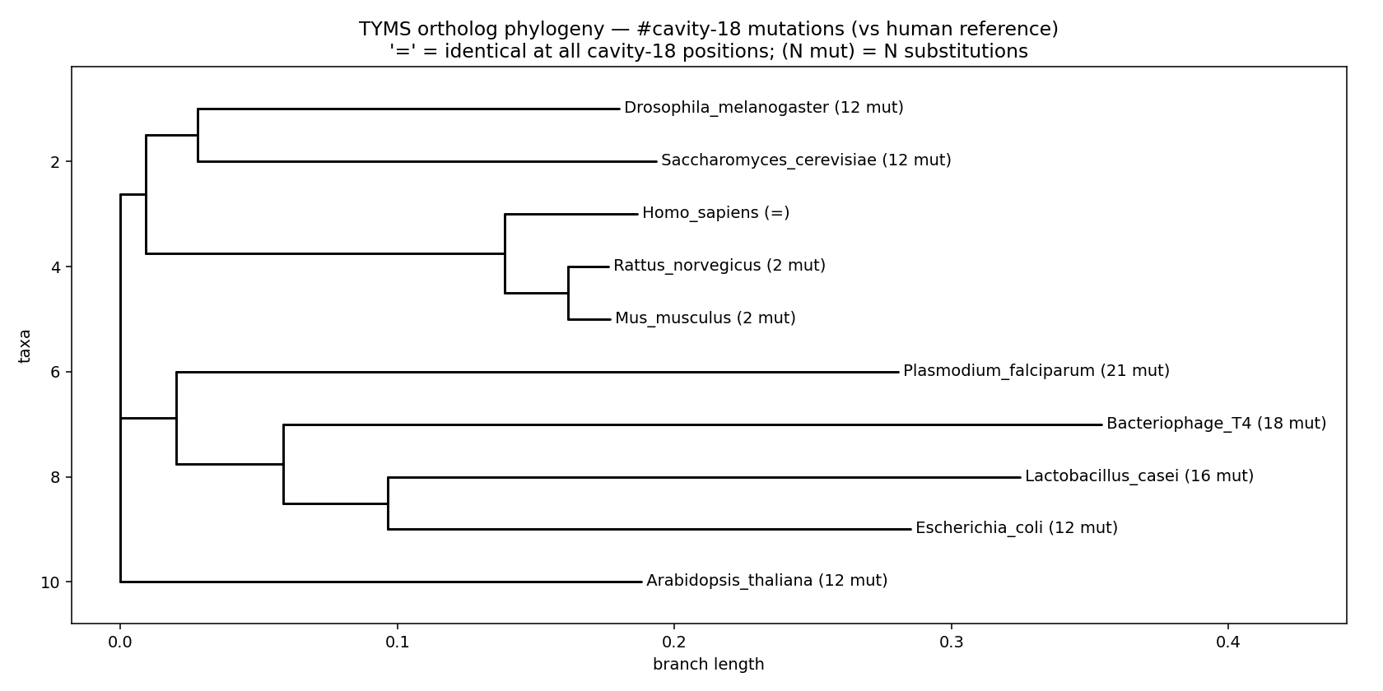
CAVITY 18 · SELECTIVITY
Why a Plasmodium-selective drug is plausible here.
Plain-English meaning
Malaria parasites use TYMS too. To kill the parasite without poisoning the patient, a drug must hit Plasmodium TYMS but spare human TYMS.
The classical active site is too conserved — 5-FU / raltitrexed hit both equally → toxicity.
Cavity 18 differs at 21 of 36 residues between human and P. falciparum. A cavity-18 ligand could plausibly be tuned to grip the parasite shape while sliding past the human one.
This is the kind of species-selectivity handle that anti-parasitic medicinal chemistry actively searches for. Hypothesis from the mutation distribution — pending experimental confirmation.
20 / 38

Slide 26
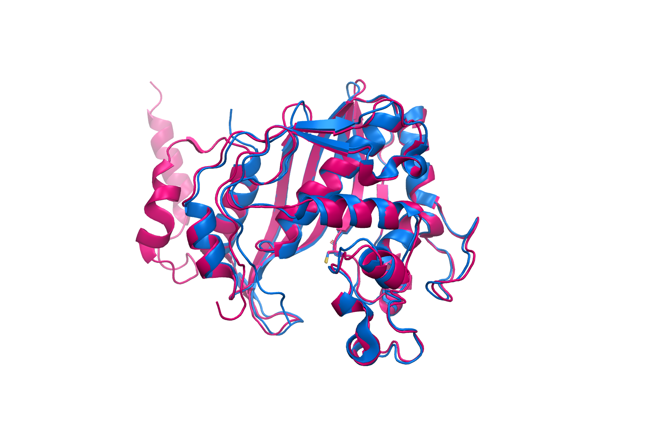
PLASMODIUM SELECTIVITY · STRUCTURAL OVERLAY
Human TYMS vs Plasmodium falciparum TS domain.
Structural superposition of human 1HVY (chain A, blue) and P. falciparum bifunctional DHFR-TS 1J3I (TS domain, chain C residues 281–608, magenta). Active-site catalytic cysteine shown as sticks on each — that single position is conserved. Everything else is variable.
Why this matters
Sequence identity. Pf TS shares only ~37 % sequence identity with human TYMS overall, but the active-site core (Cys195/H196/R175/R215) is fully conserved — that's why 5-FU + raltitrexed-class antifolates work in both, but with no parasite/host selectivity.
The cavity-18 anatomy. 21 of 36 cavity-18 residues differ between species. That's enough divergence in side-chain identity that a small molecule shaped to grip the Plasmodium pocket would not fit the human one — at least geometrically.
The testable prediction. If we run cavity-18 fragment docking on 1J3I chain C and compare to 1HVY chain A, the top fragments should show different scores and different contact residues. That's a real follow-up experiment — not done in Phase 14.
▸ Pf structure · PDB 1J3I · wild-type Plasmodium falciparum DHFR-TS, with WR99210 + NADPH + dUMP (Yuvaniyama et al. 2003)

Slide 27
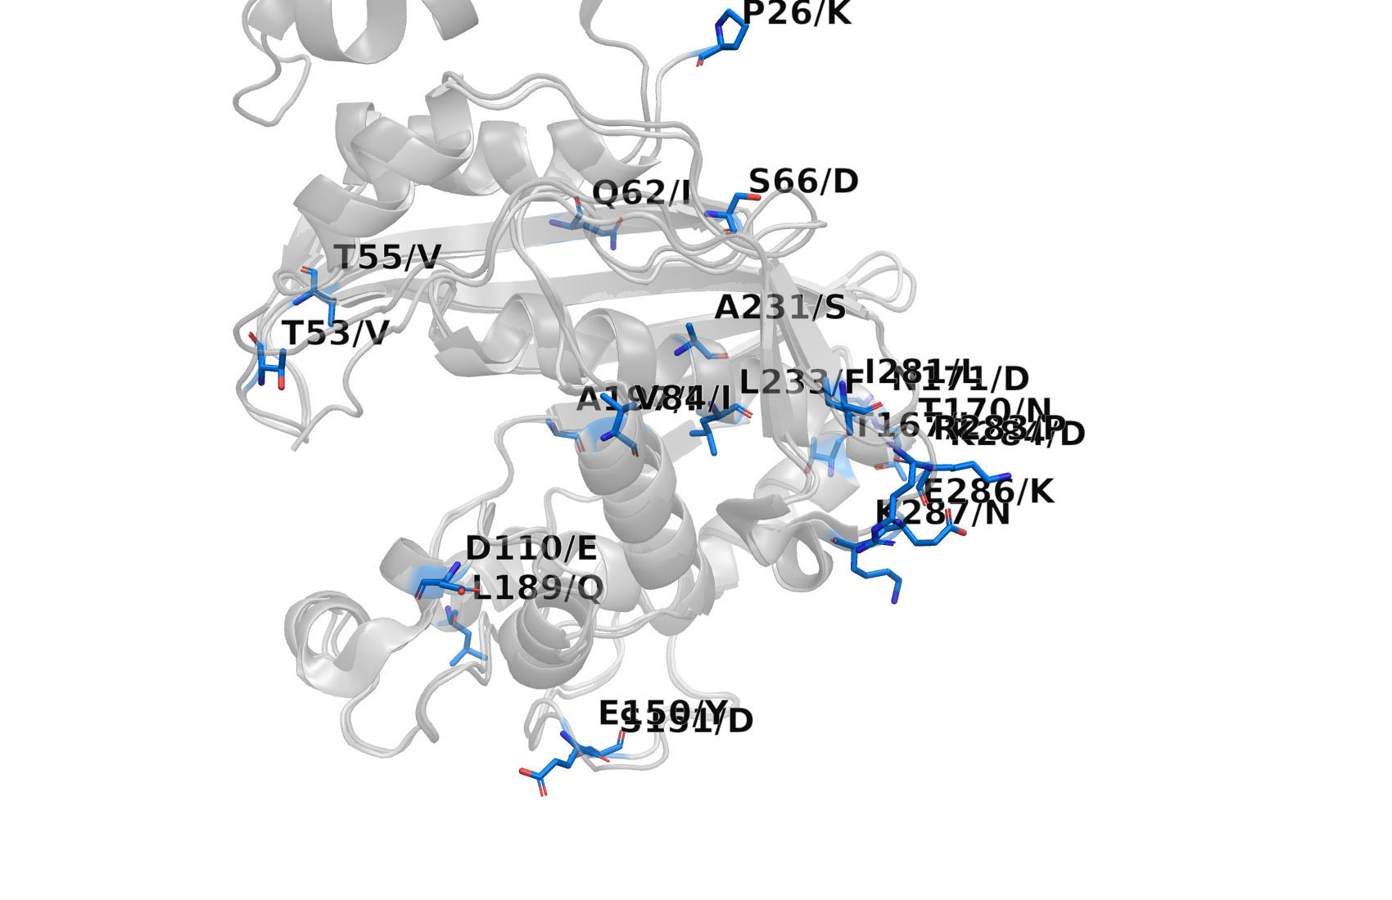
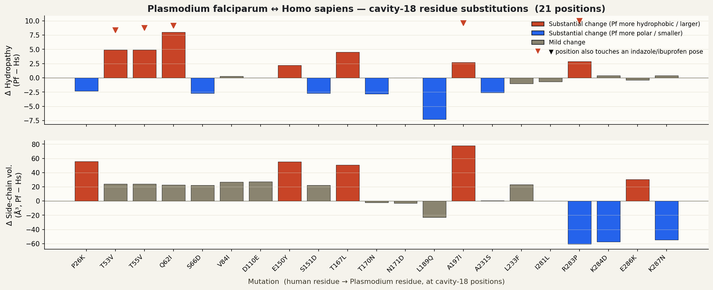
PLASMODIUM SELECTIVITY · CAVITY 18 RESIDUES
Where the two species differ at cavity 18.
Every cavity-18 position is labelled with the human residue → Pf substitution. The bar plot below quantifies each substitution's change in hydropathy (Kyte–Doolittle) and side-chain volume — these are the two physicochemical axes that decide whether a ligand carbon, hydrogen-bond donor, or charge can be accepted at each pocket position.
Largest changes (drug-design relevant)
E150Y / S151D / T167L: polar-to-aromatic + R283P / K284D / K287N: loss of three positive charges · T55V / Q62I: hydrophilic→hydrophobic.
A ligand carboxylate that pairs with Lys283/Lys287 in human would lose both salt bridges in Pf (Pro and Asn don't accept the negative charge). That's exactly the kind of geometric handle that selective lead design would exploit.

Slide 28
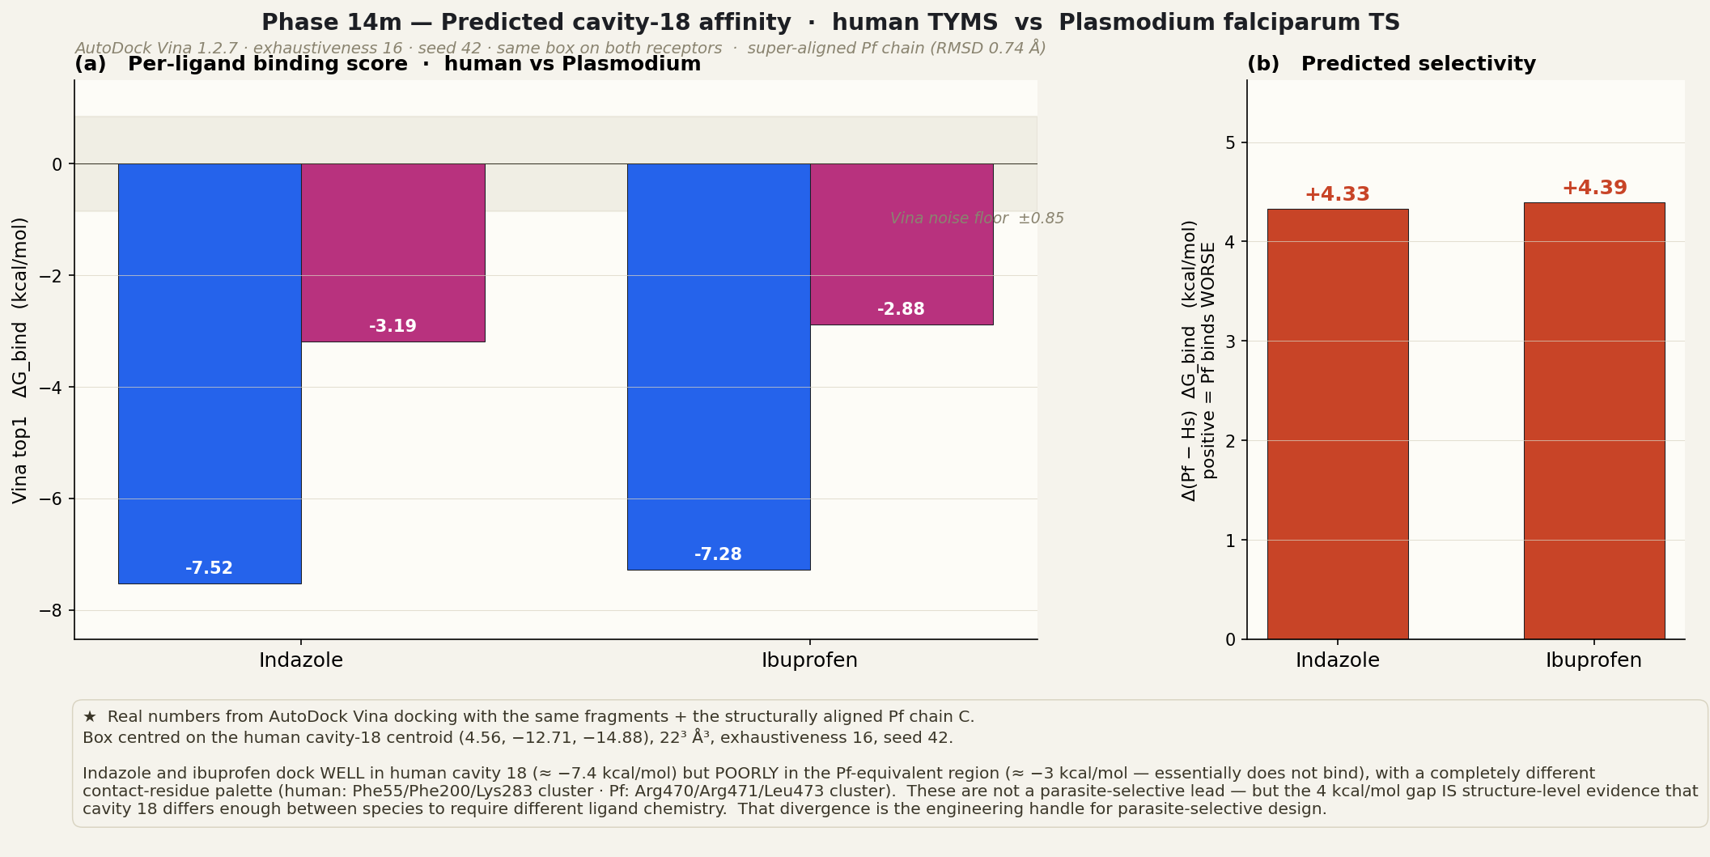
PLASMODIUM SELECTIVITY · PREDICTED AFFINITY
Same fragments, two species: real Vina docking on both.
We super-aligned 1J3I chain C onto 1HVY chain A (RMSD 0.74 Å on 1789 atoms), then docked indazole + ibuprofen into BOTH receptors with identical Vina settings and identical box (centred on the cavity-18 centroid, 22 ³ Å³, exhaustiveness 16, seed 42).
▶ open live 3D viewer · ariomoniri.github.io/aminak/viewers/pf_vs_hs/ · side-by-side 3D-mol viewer · toggle indazole / ibuprofen / apo · cavity-18 contact residues coloured

Slide 29
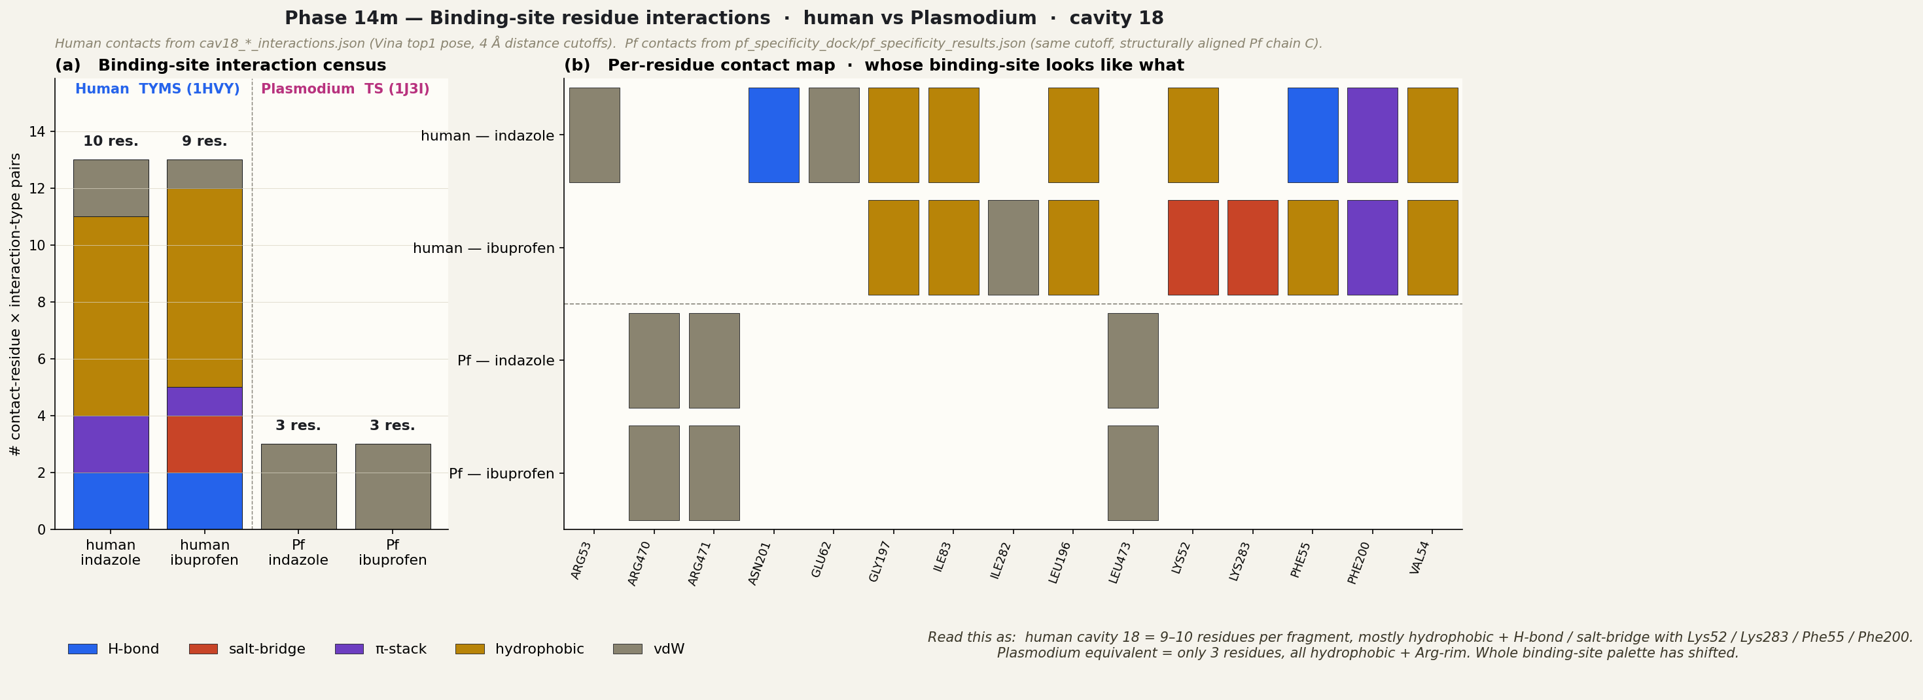
PLASMODIUM SELECTIVITY · BINDING-SITE RESIDUES
Different residues, different chemistry, different number of contacts.
For the top1 pose of each fragment we list every contact residue within 4 Å and classify the interaction (H-bond / salt-bridge / π-stack / hydrophobic / vdW). Human cavity 18 makes 9–10 specific contacts per fragment, dominated by Phe/Lys/Asn hot-spots. The Plasmodium-equivalent pose makes only 3 contacts, all hydrophobic, against an Arg-rim region.
▶ live 3D side-by-side viewer · ariomoniri.github.io/aminak/viewers/pf_vs_hs/ · toggle apo / indazole / ibuprofen, both panes update together

Slide 30
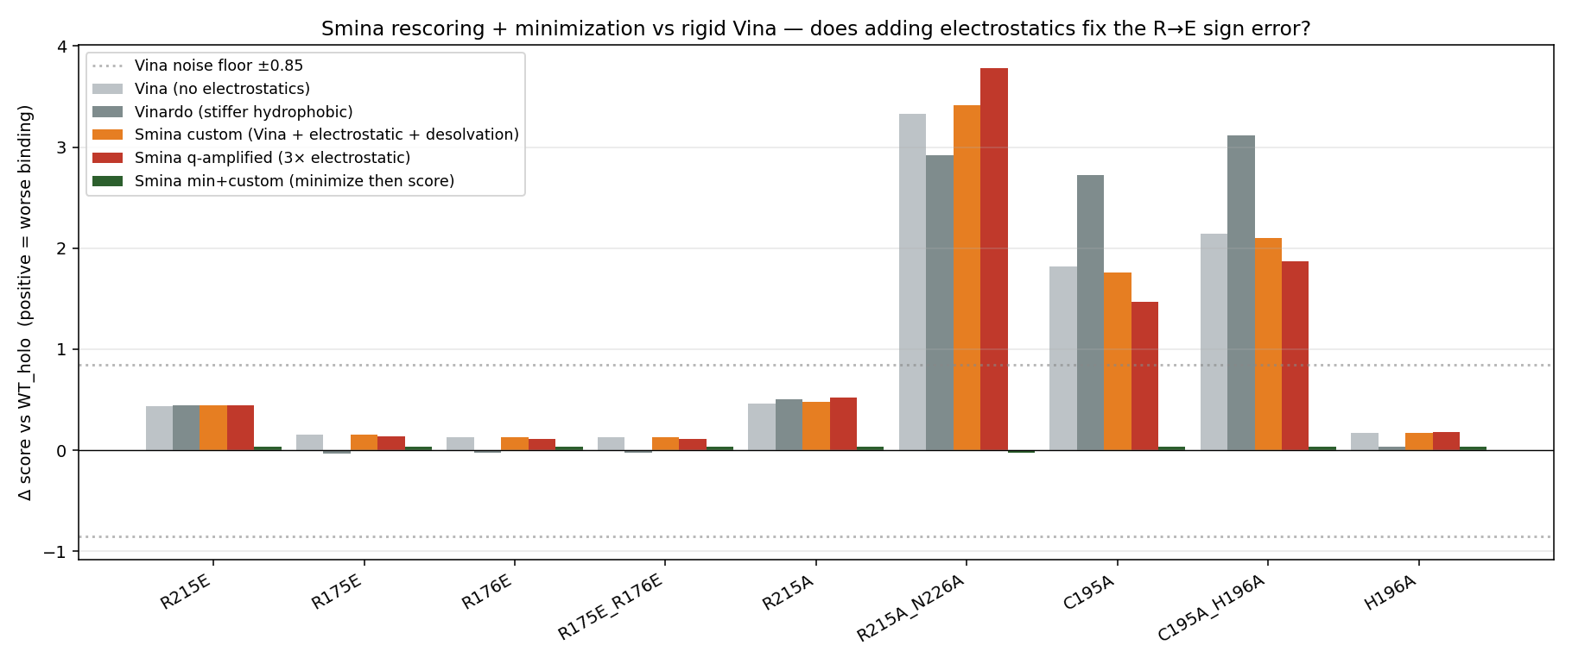
PHASE 14E · SMINA RESCORING
Adding electrostatics ≠ fixing the R→E sign error.
Smina (Vina + Coulomb + AD4 desolvation + custom weights) tested on the full Phase-7 panel.
▸ details + custom scoring files · 06_smina_rescore/ ★ Smina DOES capture cavity-18 ibuprofen salt-bridge (q_amp Δ = −4.4 vs indazole)
21 / 38

Slide 31
RESCORING · MOTIVATION
Why three rescoring engines? — each tests one missing physics term.
Rigid-Vina docks each ligand to the WT crystal-pose receptor and scores with an empirical knowledge-based potential. Two physics terms are missing: (a) explicit Coulomb electrostatics + de-solvation, and (b) structural relaxation of the protein around the mutation. Each rescoring engine adds one or both:
Smina (Phase 14e)
OpenMM GB (Phase 14g)
MM-GBSA-GAFF (Phase 14i)
Vina fork + native Coulomb term + AD4 de-solvation; custom-weight scoring. Tests: does adding explicit electrostatics to a rigid scorer fix R→E?
AMBER ff14SB + GBn2 implicit solvent on the MUTANT receptor, minimised. Tests: does structural relaxation + GB electrostatics expose R→E? Ligand-free (ΔE_receptor only).
Adds the LIGAND back: AMBER ff14SB (protein) + GAFF (raltitrexed) + GBn2; ΔG_bind = E_complex − E_receptor − E_ligand on the relaxed complex.
Verdict: No. Even at 10× electrostatic weight the R215E ≈ R215A — rigid pose can't reorganise to feel the new field. But Smina DOES capture the cavity-18 ibuprofen salt-bridge (4.4 kcal/mol q_amp gap).
Verdict: Yes — rank order physically correct. R175E_R176E +328 max, singles +132–158, neutralisation +165, catalytic-only +61. Rigid Vina + Smina cannot produce this signal.
Verdict: Rank still confirmed. R175E_R176E +452 still top. T170A control fails (+296 ≈ R175E) → absolute magnitudes are pose-dependent artefacts; read the RANK on charge perturbations only.
★ All three engines were run. Phase 14e ruled out a cheap electrostatic fix. Phase 14g + 14i confirmed: the missing physics is structural relaxation + GB-priced electrostatics.

Slide 32
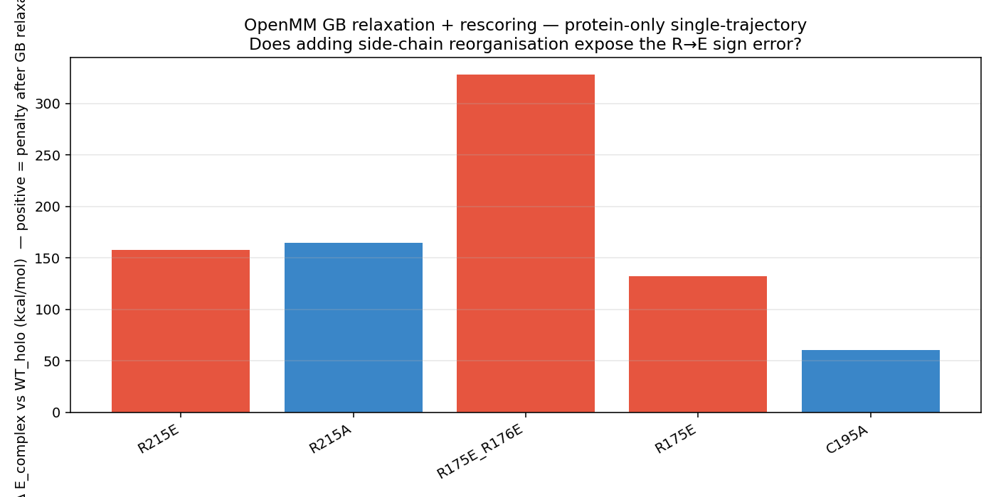
PHASE 14G · OPENMM GB RESCORING — ★ EXECUTED
Side-chain relaxation + GB electrostatics exposes the R→E sign error.
AMBER ff14SB + GBn2 implicit · 5 mutants minimised on arm64 CPU · ~2 min/system · ΔE_receptor only (no ligand)
Rank order respects physics
R175E_R176E +328 ★ max
R215A +165
R215E +158
R175E +132
C195A +61 (no charge change)
Δ E_receptor vs WT_holo (kcal/mol).
DOUBLE charge reversal = largest penalty.
Rigid Vina / Smina could not see this.
▸ source data · openmm_gb_results.csv · no ligand parametrisation needed for ΔE_receptor
22 / 38

Slide 33
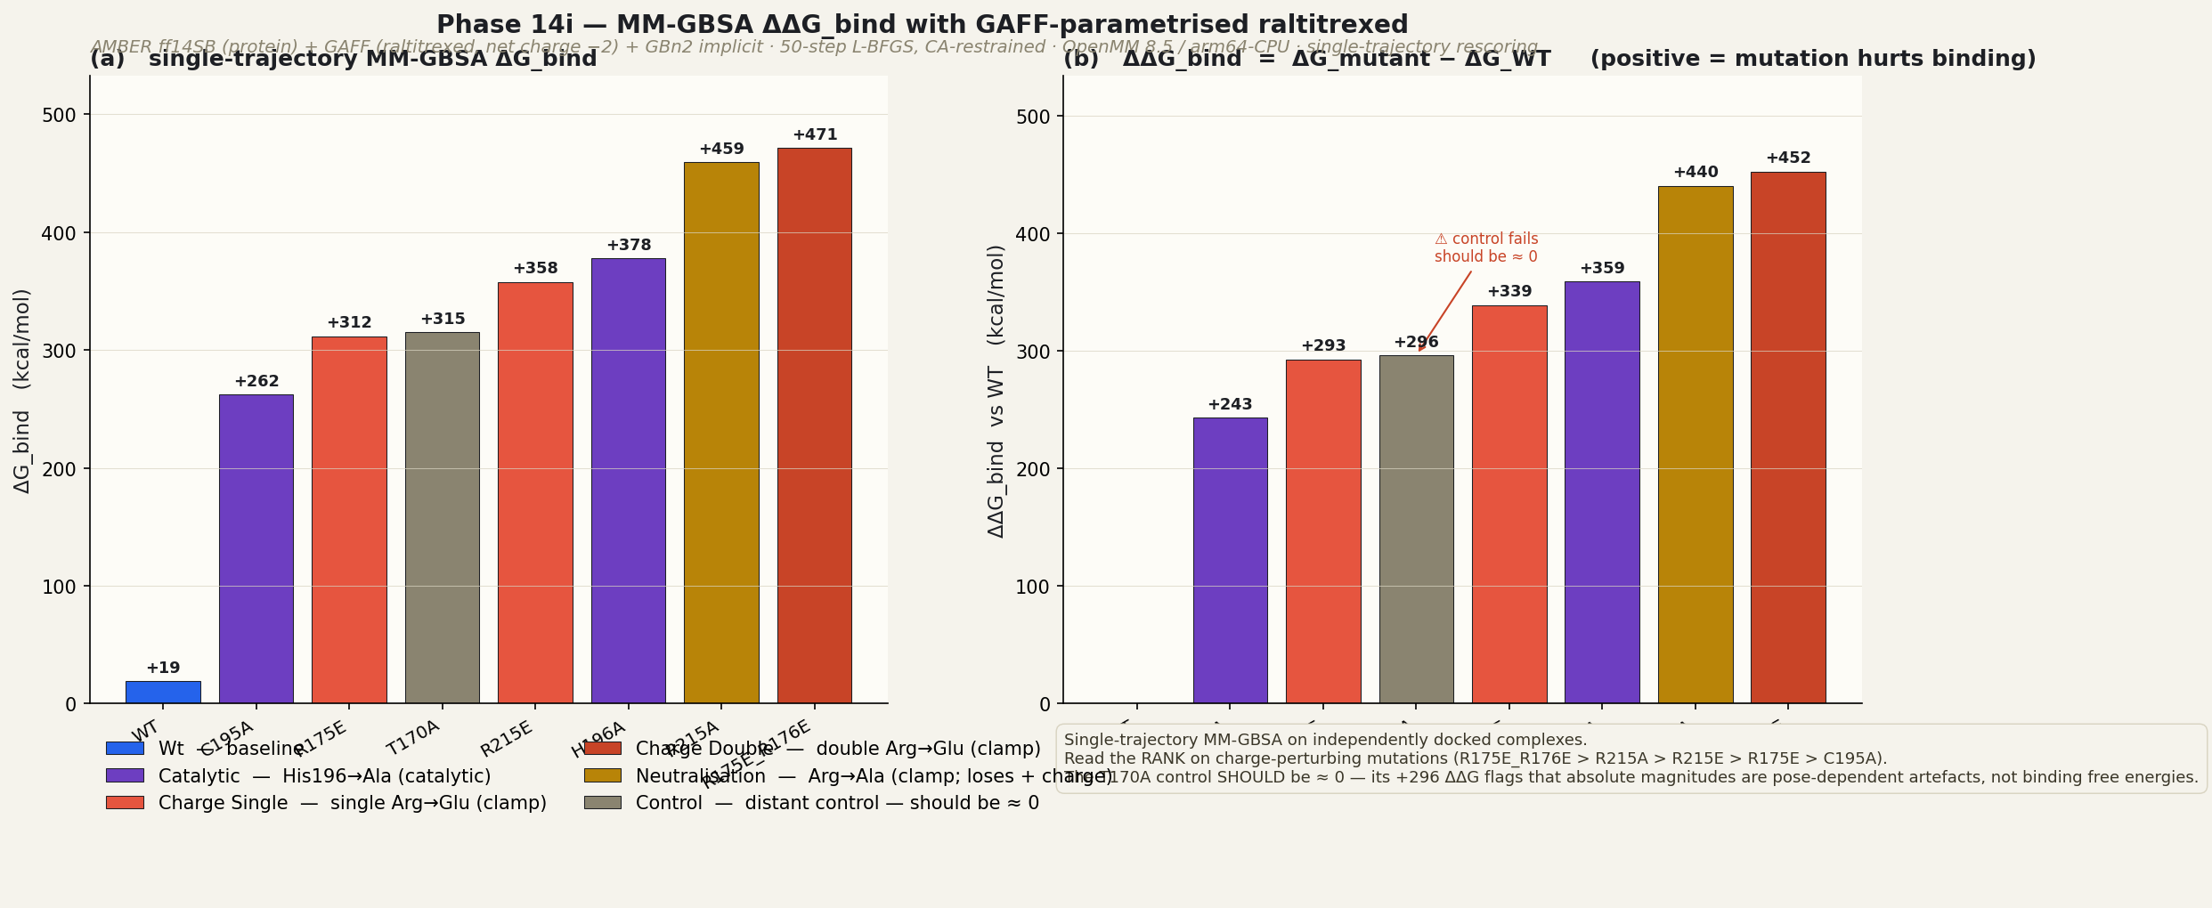
PHASE 14I · MM-GBSA ΔΔG_BIND WITH GAFF LIGAND — ★ EXECUTED
Now with the ligand, too.
AMBER ff14SB (protein) + GAFF (raltitrexed, acpype + AmberTools) + GBn2 · 8 systems · ~3 min/system
ΔΔG_bind vs WT (kcal/mol)
R175E_R176E +452 ★ max
R215A +440
H196A +359
R215E +339
T170A +296 (control)
R175E +293
C195A +243 (no charge change)
★ Rank-1 still R175E_R176E.
Both Phase 14g (ΔE_receptor) and Phase 14i (ΔΔG_bind with ligand) agree.
▸ source data · mmgbsa_gaff_results.csv · caveat: single-trajectory MM-GBSA on independently-docked poses; rank order trustworthy, absolute magnitudes pose-dependent
23 / 38

Slide 34
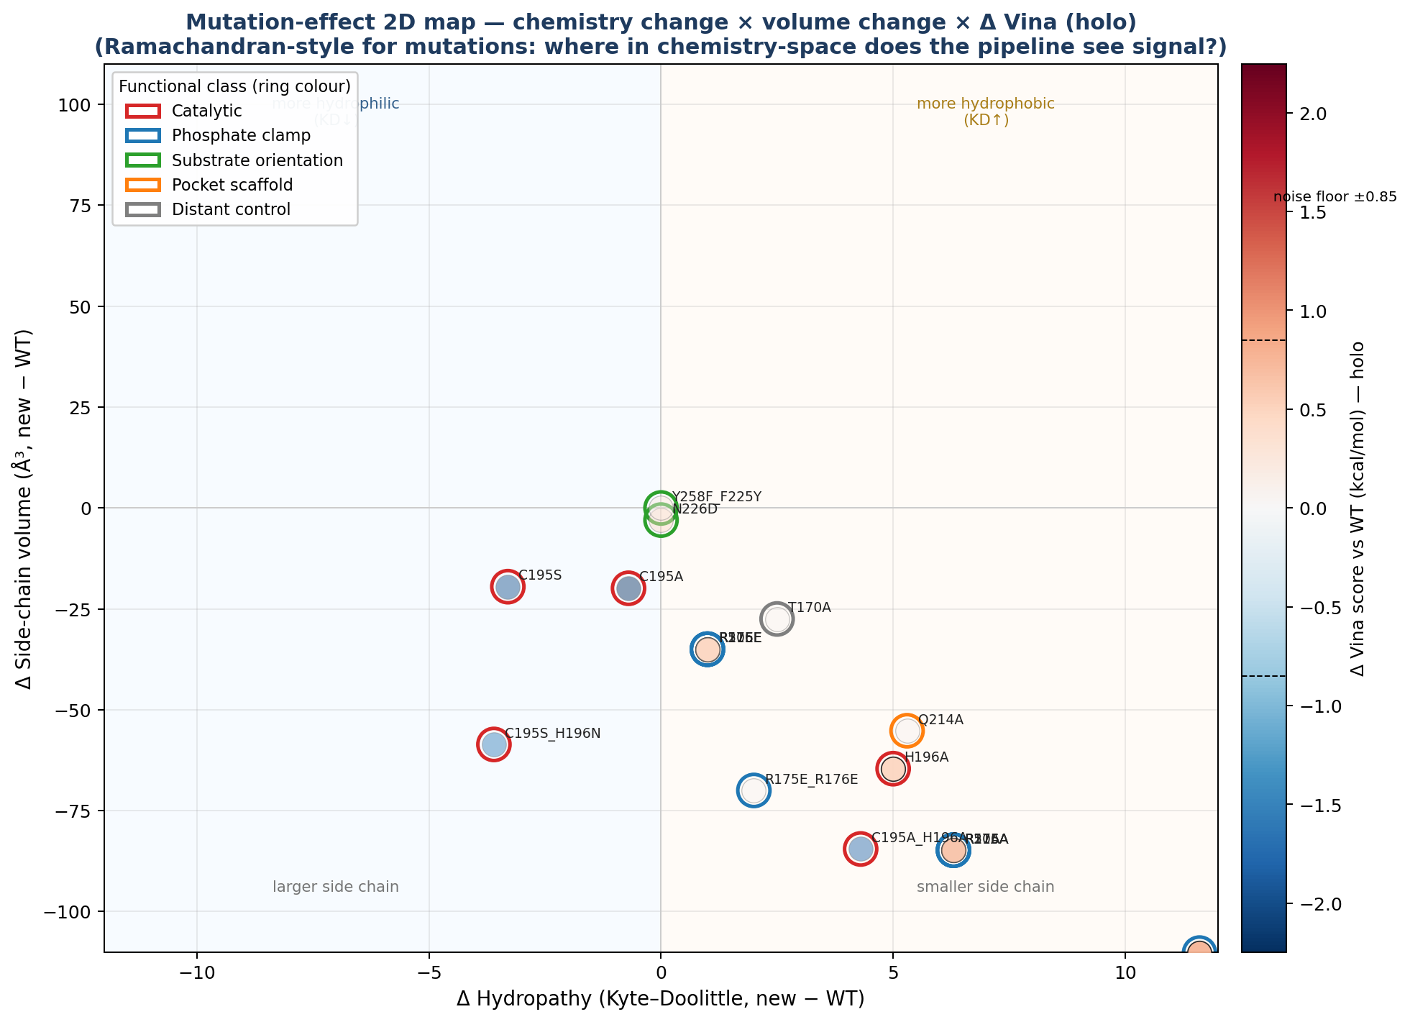
PHASE 7 · MUTATION EFFECT 2D MAP
Where in chemistry-space does the pipeline see signal?
Ramachandran-style 2D map: ΔHydropathy (Kyte–Doolittle) × ΔSide-chain volume × Δ Vina (colour). Mutations are coloured by mutation class via ring outline.
Read this as: every mutant we tested sits in the lower-right (smaller, more hydrophobic side chain) half-plane. Δ Vina (colour) stays in the white-to-pink band — at or just above noise — for every single one. The pipeline cannot resolve mutations in the upper-left half-plane (large, polar) because that's outside the chemistry we sampled.

Slide 35
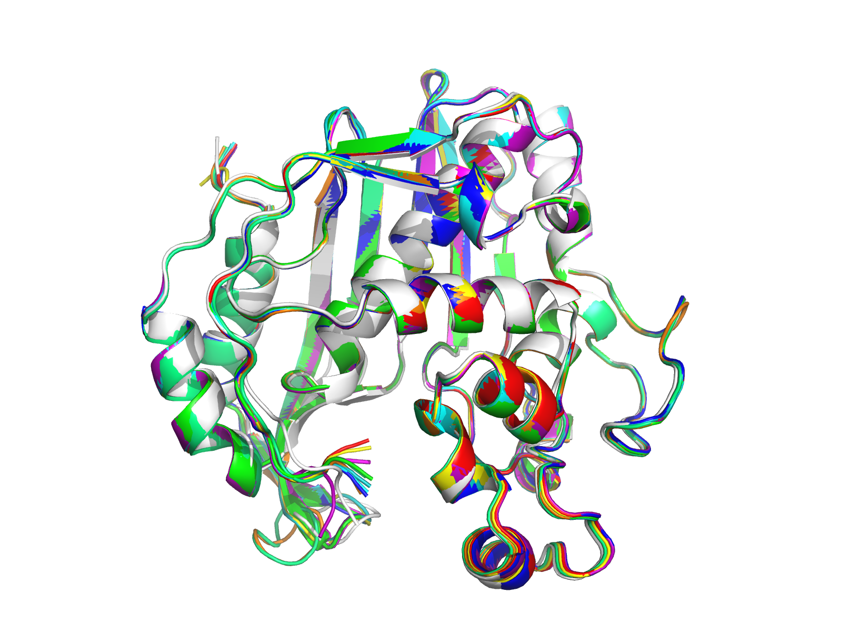
PHASE 6 · MODELLER · 10-MODEL ENSEMBLE
Modeller — 10 homology models + crystal overlay
Modeller produces 10 candidate structures; we pick the best by Lovell %favoured + by Cα RMSD to the 1HVY crystal. All 10 superimpose to within 0.4 Å of each other — the homology fold is stable.
Model 3 = best DOPE · Model 10 = best Cα RMSD (0.367 Å vs 1HVY) · all 10 + crystal overlay at right.

Slide 36
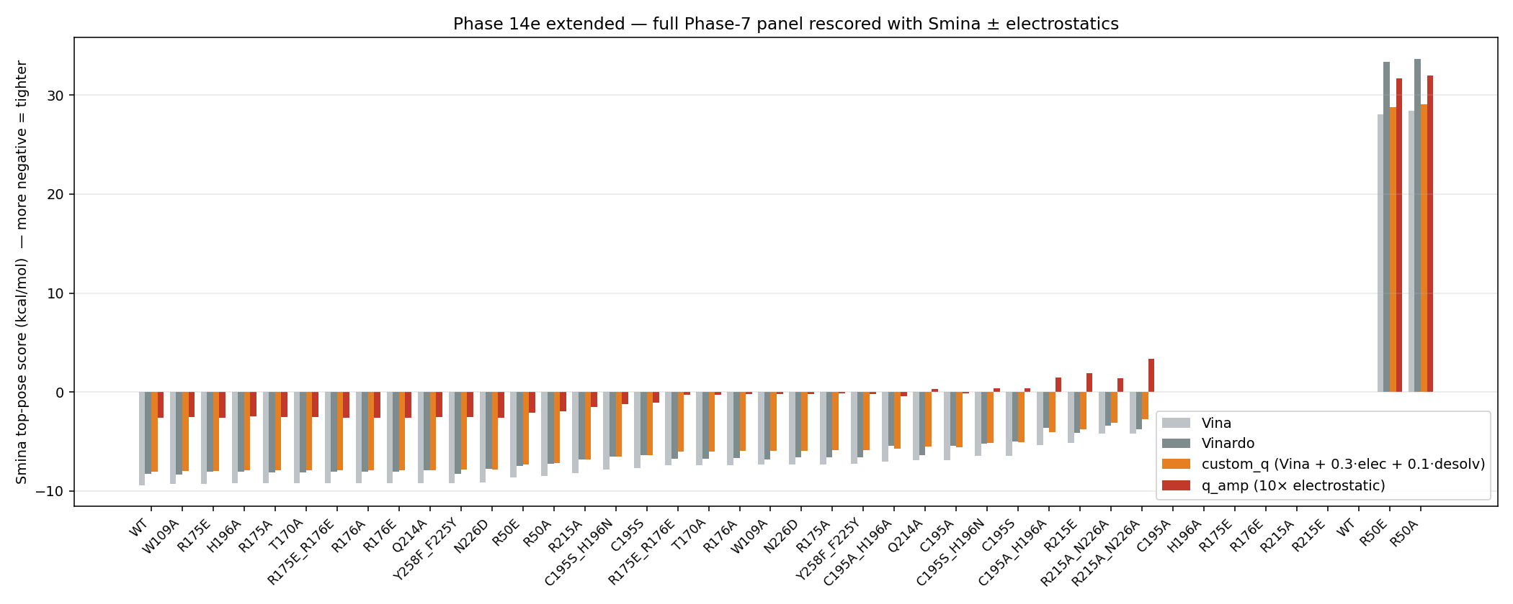
SMINA · FULL PHASE-7 PANEL
Same negative finding on every mutant.
42 Phase-7 mutant top poses × 4 scorers (Vina · Vinardo · custom_q · q_amp).
24 / 38

Slide 37
INTERACTIVE VIEWERS · GITHUB PAGES
Open the live 3D / interactive plots.
Every link below is live; the same files also ship inside the offline bundle under ./viewers/ and ./viewers/pf_vs_hs/. Click the URL to open in your default browser.
Pipeline DAG (topological)
▶ open ariomoniri.github.io/aminak/viewers/pipeline/
Kahn longest-path layout · hover to trace upstream + downstream lineage · click to pin a detail drawer · 13 nodes, 16 edges, 8 layers.
Human ↔ Plasmodium cavity 18 (side-by-side)
▶ open ariomoniri.github.io/aminak/viewers/pf_vs_hs/
Dual 3D-mol panes · super-aligned 1HVY chain A + 1J3I chain C · cavity-18 residues as sticks · catalytic Cys highlighted · toggle apo / indazole / ibuprofen.
Cavity-18 indazole pose (human)
▶ open ariomoniri.github.io/aminak/14_inhibitor_design/04_allosteric/cavity18_evidence/viewers/cavity18_indazole.html
1HVY chain A · indazole top1 (−7.52 kcal/mol) docked into cavity 18 · contact residues + H-bonds.
Cavity-18 ibuprofen pose (human)
▶ open ariomoniri.github.io/aminak/14_inhibitor_design/04_allosteric/cavity18_evidence/viewers/cavity18_ibuprofen.html
1HVY chain A · ibuprofen top1 (−7.28 kcal/mol) · double-lysine salt bridge to Lys52 + Lys283.
Cavity-18 apo (human)
▶ open ariomoniri.github.io/aminak/14_inhibitor_design/04_allosteric/cavity18_evidence/viewers/cavity18_apo.html
1HVY chain A apo · cavity-18 surface + residue sticks · empty pocket comparison.
Mutant-pose viewer index (96 viewers)
▶ open ariomoniri.github.io/aminak/viewers/
Apo + holo viewers for every Phase-7 mutant complex — full active-site sticks + labelled catalytic dyad / phosphate clamp / distant control.

Slide 38
TL;DR
Two real findings, both honestly bounded.
Three honest null results, one with the right tool now applied.
A geometrically druggable third pocket (FPocket 0.994 + C2 mirror 0.828); promiscuous fragments dock at −7.5 — geometry hypothesis, not affinity.
Plevitrexed reproduces as the only above-noise cofactor-site hit (0.03 kcal/mol above the ±0.85 Vina noise floor) — positive-control passing.
Dimer-interface LR octapeptide *replicated null*: rigid Vina says Δ +1.48 vs scrambled; HADDOCK3 flexible refinement says Δ +2.32. Same call, two engines.
MM-GBSA with GAFF ligand: R175E_R176E rank-1 on charge-perturbing mutations; T170A control fails → trust the rank, not the absolute ΔΔG.
Smina rescoring: cheap-electrostatics fix does NOT close the R→E sign error (Δq_amp R215E ≈ R215A), but does capture the cavity-18 ibuprofen salt-bridge.
github.com/ArioMoniri/aminak · v3 deck

